Slide 1
14 – Clean Code – SOLID Summary
Based on the CleanCoders videos by Uncle Bob Martin
Rupert Waldron

Slide 2
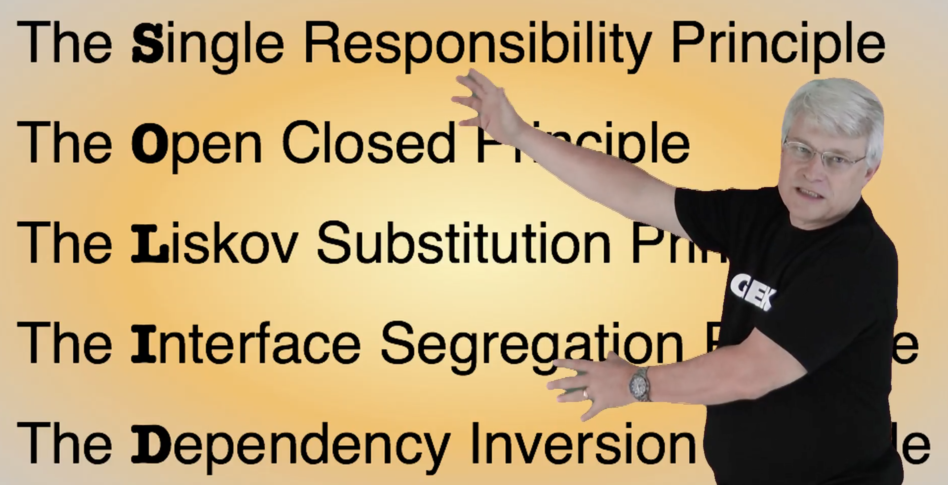
Object Orientated Design is all about Dependency Management
Uncle Bob gives us these dependency management principles that control operations and relationships between classes

Slide 3
Payroll Case Study
Requirements:
The system needs to be able to perform CRUD operations on each employee.
There are three types of employee all paid on a different schedule:
Hourly employee pay is based on an hourly rate and is paid weekly.
Salaried employee pay is based on salary and is paid monthly.
Commissioned employee is paid base rate plus commission and is paid bi-weekly.
Employees can change between types.
Each employee can be paid in one of three ways:
Cash
Cheque
Direct bank transfer
Employees can also be members of a union which charges members dues and service charges

Slide 4


Single Responsibility Principle
Who are the actors in this system?
Payroll
Operations
Crud ops
Paying employees
Changing wages
Updating hours
Adding commission
Union
What dues to pay
Service charges
Policy
Update payment methods
Change employee types
Add more employee types

